Slide 1
Catalytic Projects – The City of Cape Town’s Interpretation
Antony Marks
Spatial Planning and Urban Design Department
6 February 2015

Slide 2
Divergence
Key Issues:
Definition of catalytic projects
Expectations of identified projects
Multiple: projects, spheres,
Understandings and responsibilities
Project pipelines vs monitoring and milestones

Slide 3
Contents
Definitions, Expectations and Understanding
City of Cape Town’s Approach: Typology of Catalytic Projects
The project pipeline

Slide 4
Definitions

Slide 5
Catalytic Projects - BEPP
2015/16 – 2017/18 BEPP Guidelines:
For the purpose of the BEPP, the definition of catalytic urban development projects is - land development initiatives that:-
a) Are integrated, that have mixed and intensified land uses where the residential land use caters for people across various income bands and at increased densities that better support the viability of public transport systems;
b) Are strategically located within integration zones in cities; and are game changers in that the nature and scope of the projects are likely to have significant impact on spatial form.
c) Require major infrastructure investment;
d) Require a blend of finance where a mix of public funds is able to leverage private sector investment as well as unlock household investment;
e) Require specific skills across a number of professions and have multiple stakeholders.

Slide 6
Catalytic Projects - BEPP
2015/16 – 2017/18 BEPP Guidelines:
The BEPP process will focus on catalytic urban development projects in respect of primary and secondary Precincts/Nodes/Hubs and transit oriented development (improving the alignment between Human Settlements and Public Transport).
In the case of Cape Town - the integration zones/ priority TOD corridors are the Voortrekker Road Corridor and the Central City – Metro South-East Corridors, key within these are Bellville, Philippi, etc.

Slide 7
Inferred Criteria re: NDHS Master Spatial Plan
Cape Town’s Catalytic projects included into :
50 National Priority Projects
1,5million National delivery target
Reflective of:
typology / product “mix”: 30% BNG; GAP 20%; Social Housing 10% & Serviced Sites 20%
“At-scale” delivery >10,000 units
Partnership between government and private partners
NDHS / HDA will use Catalytic projects to:
Prioritise, target and focus resources (incl. financial)
Mobilise Inter-governmental support, co-ordination and alignment (incl. “PHDA”)
Demonstrate Impact and Integration
Support & encourage public / private sector collaboration
Promote job creation esp. among youth located in the project areas

Slide 8
Catalytic Projects - ICDG
ICDG (Guidelines 2013/14)
At a programme level these zones include opportunities or requirements for catalytic public investment in:
Core urban infrastructure services, such as bulk and connector water, sanitation, energy or solid waste infrastructure
Land and human settlements development, including opportunities for land development and release, public and social housing, and upgrading of informal settlements
Economic infrastructure investments, such as upgrading of business districts, the provision of improved street and pavement infrastructure and open space systems.
Public transport infrastructure and services

Slide 9
Catalytic Projects – Game Changers
Digital Competitiveness
After-School Interventions
Liquid Natural Gas
Transport Oriented Development
Alcohol Abuse
Live, Work, Play
Joined Up Government

Slide 10
City of Cape Town’s Approach - Typology of Catalytic Projects

Slide 11
Catalytic Projects (as requested for BEPP – guidelines Oct 2014)
Human Settlements
i.e. Southern Corridor sustainable neighbourhoods project; North-Eastern Corridor public private partnership project; Voortrekker Road Integration Zone social housing project; District 6 land reform project
Urban Development
e.g. Athlone Power Station (APS); Two River Urban Park (TRUP – Province); Conradie Hospital
Infrastructure
Mayoral Urban Regeneration Programme (MURP); PRASA Station upgrade programme
Programmes / Processes
BRT (Wetton/Lansdowne Rd & Symphony Way); Plattekloof Substation Upgrade; Blue Downs Rail Link
City’s interpretation and framework for compiling catalytic project

Slide 12
Catalytic Interventions
NB: interventions do not have a project manager appointed / have not reached the stage where they constitute projects.
However, significant potential to restructure the City. Targets should relate to actions to unlock land / prove dev. concept / feasibility
Wingfield Redevelopment
Stikland Hospital Redevelopment
Belville CBD
Etc.
Need to be considered as part of a potential project pipeline re:
Pre-feasibility
Concept Development / Conceptual Design
Feasibility Assessment
Site Packaging / Detailed Design
Land Release / Procurement
Development / Construction

Slide 13
Project Pipeline

Slide 14
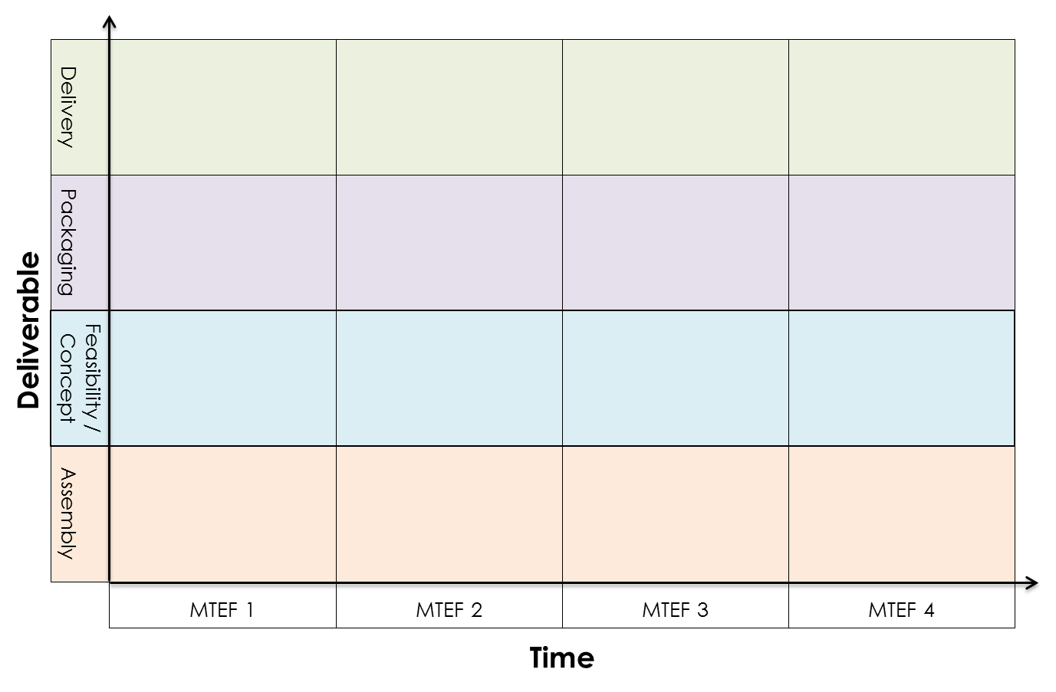
Project Pipeline vs Monitoring, Milestones and Deliverables

Slide 15
Project Pipeline vs Monitoring, Milestones and Deliverables

Slide 16
“Catalytic” Public Land Development Pipeline
The State has a significant, potentially “catalytic” land holding portfolio in CT
The value in these landholdings lies in their infrastructure and development rights
The authority/ means to create this value lies in the hands of the City – the City is central to making these land development projects happen
This value is also the negotiating instrument for leveraging public good in the development (City’s policy objectives)
Leveraging this value and ensuring return on investment is dependent on having a strategy to phase the release of public land into the market – using a land development pipeline approach

Slide 17
A Land Preparation & Release or “Pipeline” Strategy
This strategy needs to:
provide a rational basis on which to prioritise to ensure best return on effort
optimise the project team’s (importantly the City’s) capacity to work on land preparation & packaging consistently & efficiently to yield results within the next 5 – 8 years
ensure that the market has the capacity to take up the land through clear signaling, good timing of the supply of land into the market, removing risk and sustaining the market once there is demand/ capacity

Slide 18
Balance: Demand, Supply and Time
Market
Market
Subsidy
Social
Gap
Social
Local
Provincial
Residential
National
Land
Capacity
Commercial
Industrial
Demand
Supply
Time
Property
Market

Slide 19
Project Pipeline
This section details overarching work that is required to enable projects
Pre-feasibility Study
Desktop investigation
Site context
Physical conditions
Statutory conditions
Utility services and transport
Public facilities
Socio-economic conditions
Institutional Analysis
Site summary
Feasibility
High level financial feasibility
Confirm site conditions + test concept
Test concept against utilities capacity
Test concept against facilities standards
Detailed financial feasibility
Test concept against institutional analysis
Confirm concept and update
Confirm project packaging requirement
Land Release
Process to release site to developers
Spectrum: Partnership ←→ Sale
Development
Detailed design
Statutory Processes
Constructions
Concept Development
Concept Plan based on:
Macro property Assessment
Pre-feasibility study
Packaging
Risk management process
Development of business plan
Institutional model development and/ or establishment i.e. SPV / PPP
Land use approvals
Land acquisition
Consolidation and / or subdivision
Servicing of site
Detailed design and final feasibility
Note:
Time are estimates and are based on dedicated project capacity and full availability of information
Procurement process have not be considered in allocation of timelines
19

Slide 20
Project Pipeline – Project
Decision Gates
Preparatory Work
Macro Prop Assessment
Institutional Model
Projects | Pre-feasibility [3 – 6 mon] | Concept [1-3 mon] | Feasibility [3-6 Mon] | Packaging [6-36 mon] | Land Release [12 – 24 mon] | Development [12 - +240 mon]
Athlone Power Station
Kapteinsklip
Khayelitsha CBD
Bellville CBD Precinct
Two Rivers Urban Park
Conradie Hospital
Tygerberg Hospital
Somerset Hospital Precinct
Wingfield
Etc ….

Slide 21
 | Catalytic Nature |  |  |  |  |  |  |  |  | Dependencies |  | Bulk by Market and Sector
 | Integrated Income | Mixed Land Use | Land Use Intensity | Transit | IZ | Leverage Potential | Spatial Impact |  | Overall Ranking | Stakeholders | Infrastructure | Private Sector |  |  |  | Social | Subsidy | Total Bulk
 |  |  |  |  |  |  | Ranking | Description |  |  |  | Retail | Commercial | Industrial | Residential | Residential | Residential
Project X
Project Y
Project Z
Integrated Income Refers to income bands accommodated | Low: Monofunctional
 | Medium: More than one income group but not all income groups
 | High: Large range of income groups
Mixed Land Use | Low: Monofunctional land use
 | Medium: more than 2 land use type
 | High: More than 2 land use types
Land Use Intensity Floor area ratio | Low: < 0.49
 | Medium: 0.5 - 1.49
 | High: >1.5
Transit Distance to planned transit stop (note scale of development) | Low: >1.5km
 | Medium: 800m - 1.49km
 | High: 0m - 800m
IZ | MSE / VRC / NA
Leverage Potential | Low: none
 | Medium: Either leverage private sector investment or unlock household investment
 | High: Leverage private sector investment and unlock household investment
Spatial Impact | Low: impacts on site only
 | Medium: Impacts on surrounding local area
 | High: City wide impact

Slide 22
Conclusion

Slide 23
Conclusion
Human Settlements
Urban Development
Infrastructure
Programmes / Processes
Interventions
Categories of Catalytic Projects
Project Pipeline
Pre-feasibility [3 – 6 mon] | Concept [1-3 mon] | Feasibility [3-6 Mon] | Packaging [6-36 mon] | Land Release [12 – 24 mon] | Development [12 - +240 mon]

Slide 24
Insert: For queries contact (insert name.surname@capetown.gov.za)

